Slide 1
Wallstreetbets or Stocks?
By: Graham Haun

Slide 2
Objectives
Describe why this type of model is important
Present an accurate model
Display prominent features of the model

Slide 3
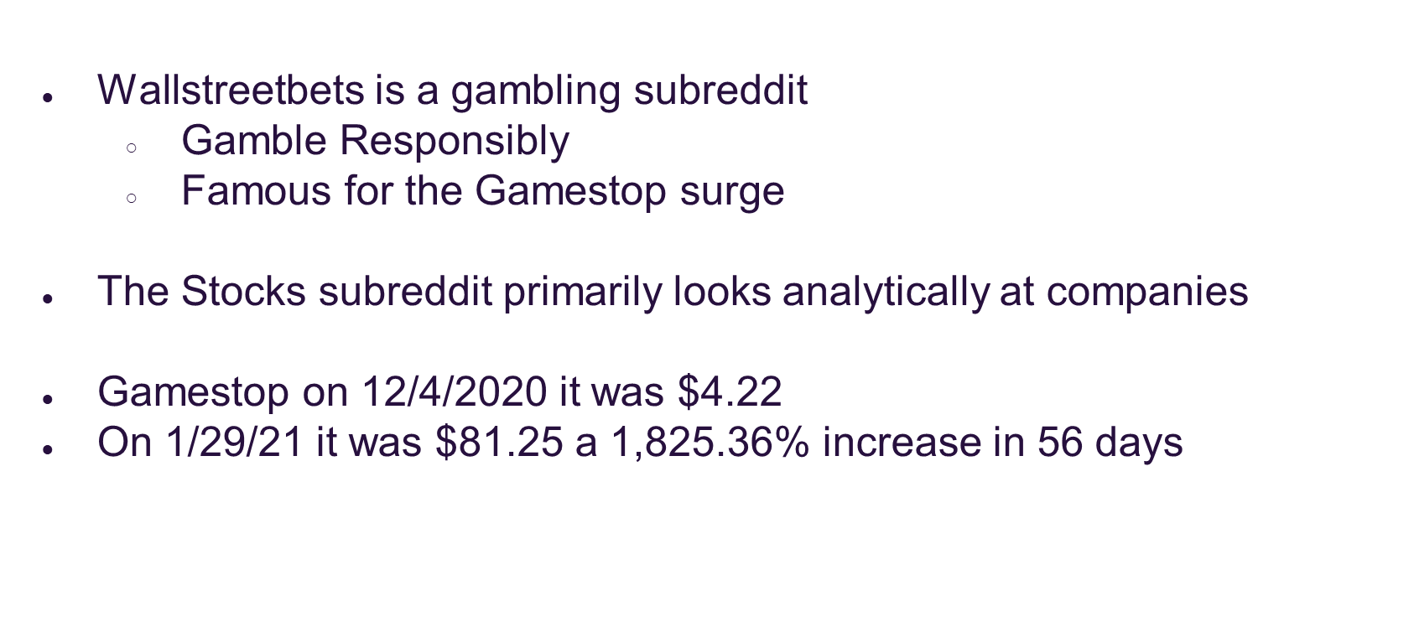
Background and Importance

Slide 4
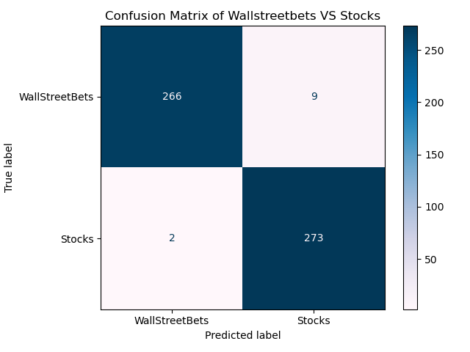
The Model
Random Forest Model Accuracy: 99%
Notes:
Precision: 99% of posts the model classified as "WallStreetBets" are actually "WallStreetBets."
Sensitivity: 99% of actual "Stocks" posts were correctly identified by the model.
Def:
Precision: The proportion of correctly predicted instances for a class among all instances predicted to be in that class. True Pos/(True Pos + False Pos)
Recall: The proportion of correctly predicted instances for a class among all true instances of that class. True Pos/(True Pos + False Neg)

Slide 5
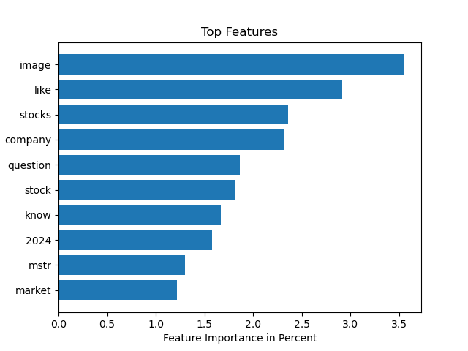
Top 10 Features
Image: A post with only a picture
mstr: Micro Strategy stock ticker
Notes:
Image contributes to 3.5% of the total importance
Feature importance calc by how much it reduces gini

Slide 6
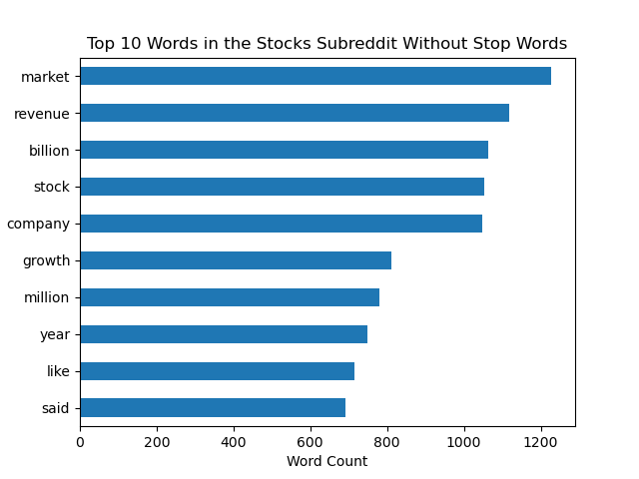
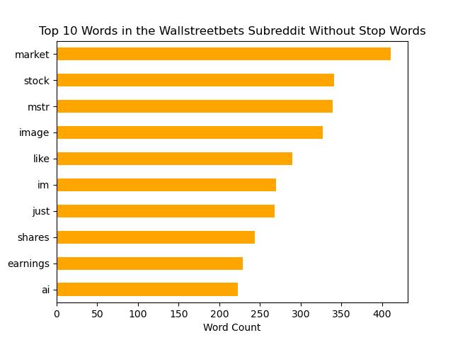
Top 10 Words From Each Subreddit

Slide 7
Future Work
Adding a sentiment analysis to individual stock posts where the poster talks about why they are buying or selling the stock
Scrape for the individual tickers
Expand to other subreddits to get a wider view of reddit’s view of the market
Predict trends and provide insight of reddit traders

Slide 8
Thanks!
Do you have any questions?
Please keep this slide for attribution

